Slide 1

Shield Insurance Analysis: Data-Driven Insights for Growth
Introduction :
This presentation explores key insights and recommendations based on a comprehensive data analysis of Shield Insurance's customer base, revenue trends, and policy performance.

Slide 2
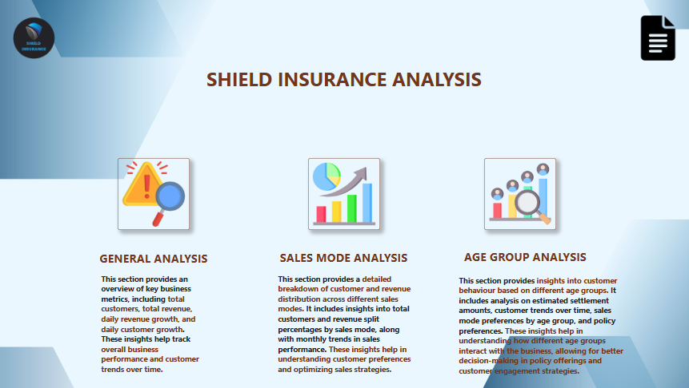

Slide 3
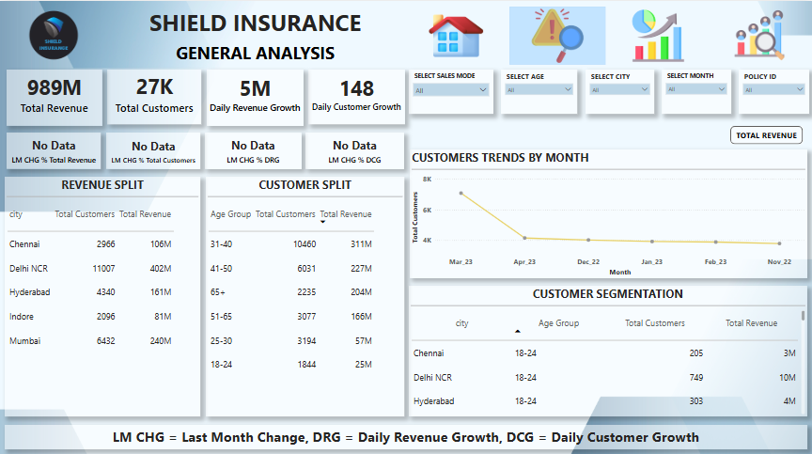

Slide 4
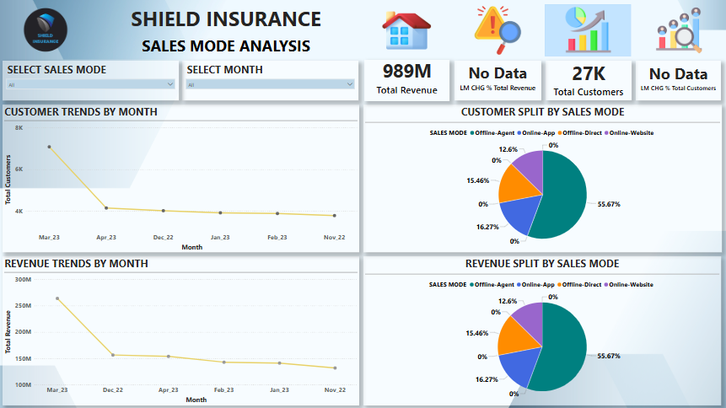

Slide 5
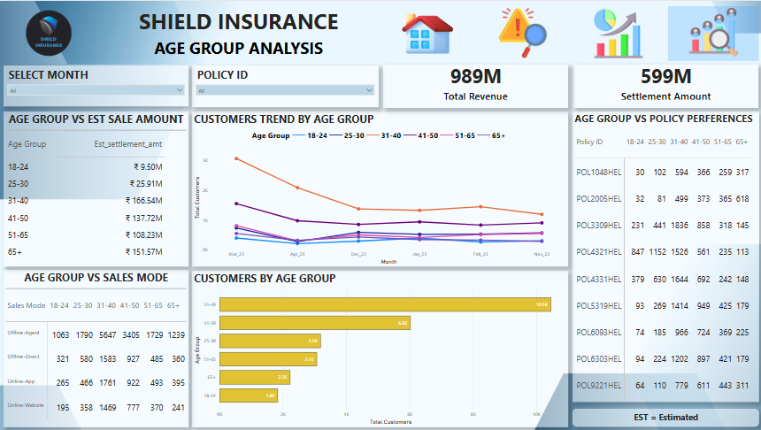

Slide 6
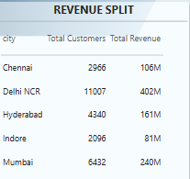
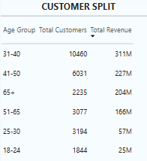
Understanding Customer Growth and Revenue
Total Revenue
Total Customers
The company generated a total revenue of 989M, highlighting a successful financial performance.
Shield Insurance boasts 27K customers, showcasing a strong customer base.

Slide 7



Sales Mode Performance: A Deep Dive
2
Online Sales
Contributes significantly, showcasing a growing digital presence
Offline Agent
Dominates with 55.67% of revenue and customer acquisition
1
Direct Sales
Accounts for a smaller proportion, indicating potential for expansion
3

Slide 8
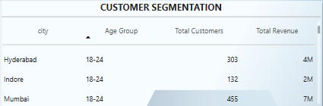
Age Group Insights: Targeting the Right Audience
Customer Distribution
Settlement Amounts
Customers aged 31-40 years contribute the most, with 10,460 customers.
Older age groups drive higher settlement amounts, indicating a greater need for insurance.

Slide 9
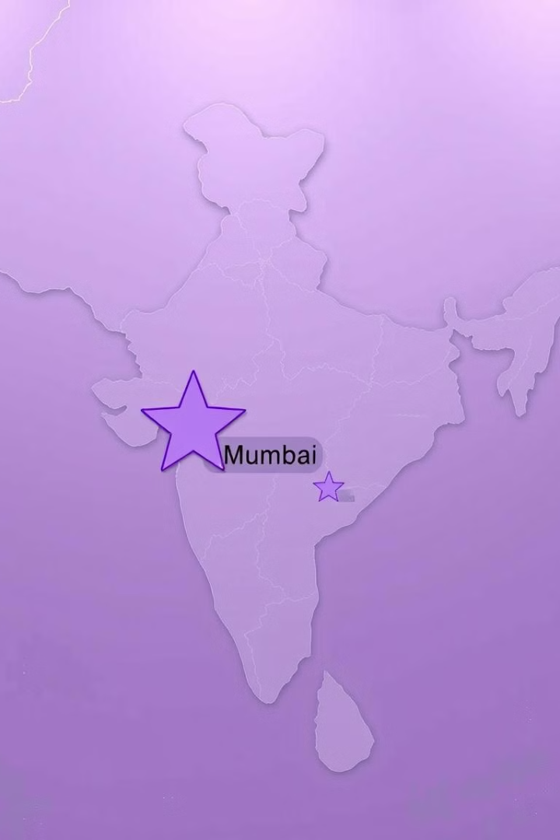
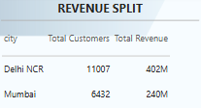
City-Wise Performance: Localizing Strategies
Mumbai
Leads in total revenue with 240M, showcasing a strong market presence.
Delhi NCR
Has the highest number of customers, indicating a significant customer base.

Slide 10

Key Recommendations for Strategic Growth
1
Implement LM CHG % calculations to track month-over-month performance trends.
2
Optimize marketing efforts in high-performing cities, explore ways to increase customer engagement in lower-revenue cities.
3
Diversify sales mode strategies to enhance customer acquisition in underperforming channels.
4
Develop age-group-specific insurance policies and promotional strategies to improve customer retention and revenue growth.

Slide 11
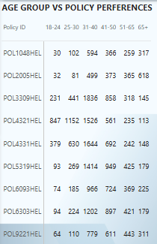

Policy Preferences by Age: Tailored Product Offerings
1
18-25
Higher preference for term life and health insurance.
2
26-35
Increased demand for home, auto, and health insurance.
3
36-45
Greater focus on retirement planning and investment products.

Slide 12

Conclusion: Data-Driven Insights for a Brighter Future
This analysis provides a clear understanding of customer distribution, revenue generation, and sales mode performance. Leverage these insights to enhance sales strategies, optimize customer engagement, and drive overall business growth.

Slide 13

Thank you!

